Slide 1
Phones and subvertising
Workshop by Eeva Kemppainen, translated by Helena Lehti
Pro Ethical Trade Finland, 2019
Notes:
‹#›
This workshop is designed for primary and secondary school. It is allowed to upload and custom it to match your own teaching. Remember to mention that the presentation is created by Pro Ethical Trade. Please notice the comments and additional information on each slide.
The presentation and material can be found on Eetti’s webpage: www.eetti.fi/oppimateriaalit
The body of this presentation can be modified, here is an example for the schedule:
Presenting Eetti and the content of the workshop + warming up (value line or the Simpsons intro) 15 min, advertising 10 min, maps and photo exercice (infographics) 20-25 min
Interim task (feedback) 5 min, interpreting anti-advertisements ja anti-advertisement gallery 15 min as a gallery or with the Agenda 2030 -table), memes or social media posts 20 min
With younger students it’s good to get oriented to the issue before the workshop and use some time to make a anti-advertisement. With older students to make the workshop more challenging, some terms and claims can be added along with street art or examples of influencing. Additional information and tips can be found at the end of the presentation.

Slide 2
Analysis of an advertisement
What product and brand is the advertisement for?
What is the tone of the advertisement?
What devices are used in the advertisement to grab your attention?
Screenshot: Apple’s big news in 108 seconds https://www.facebook.com/apple/videos/1714027778708271/
Notes:
Picture: Screenshot from Apple’s adverstisement Apple's big news in 108 seconds https://www.facebook.com/apple/videos/1714027778708271/
Be aware of colours, effects, movement, people’s roles, research, accuracy, durability and speed, as well as the feel of speed, modernism, strong and succinct texts.

Slide 3
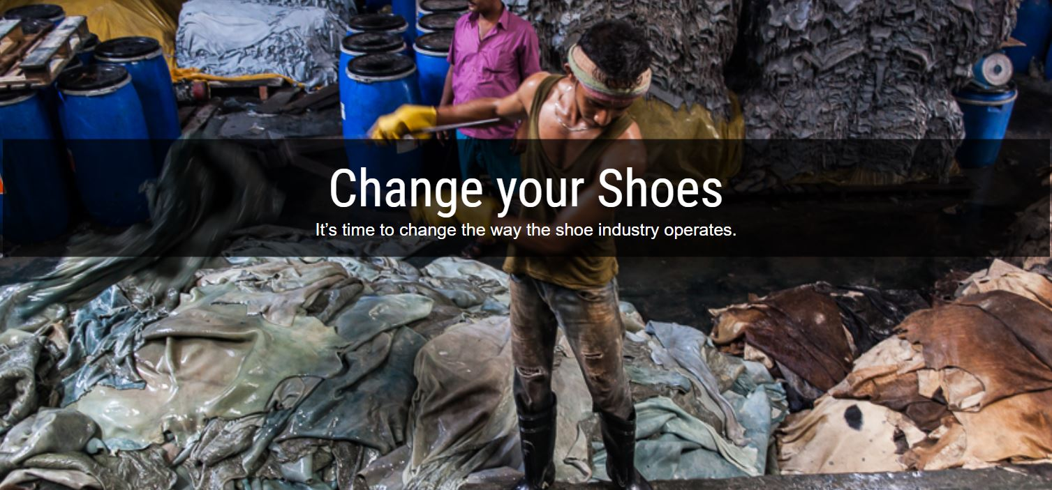
A different type of video
Source: Labour Behind the Label https://vimeo.com/143602053
Notes:
Picture: Screenshot from Apple’s adverstisement Apple's big news in 108 seconds https://www.facebook.com/apple/videos/1714027778708271/
Be aware of colours, effects, movement, people’s roles, research, accuracy, durability and speed, as well as the feel of speed, modernism, strong and succinct texts.

Slide 4
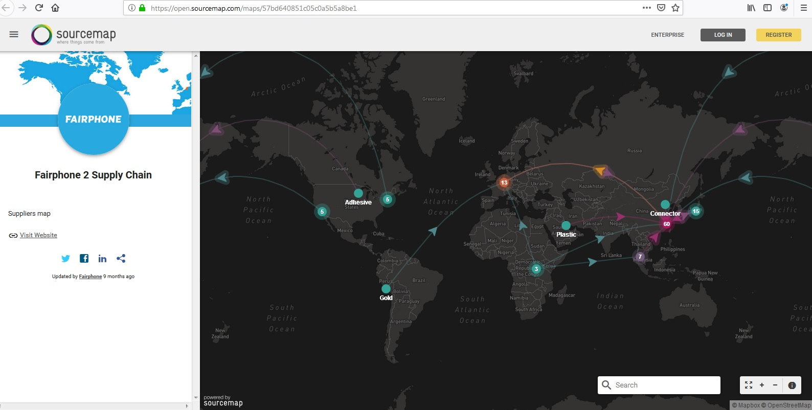
Before it gets into the shop the product has travelled around the world
Manufacturing a phone has tens of stages. A simplified example:
1. Design, IT, marketing, USA 2. Digging raw materials, Congo, Indonesia, Argentina 3. Packaging, Switzerland 4. Components, batteries, other parts, South-Korea 5. Assembly and testing, Malaysia, China 6. Finishing, ”Made in”, China 7. Transportation and sales, EU, Finalnd 8. Consuming and e-waste, Finland, Ghana
Notes:
Map: Fairphone. The interactive map of mobile phones’ supply chain and a list of subcontractors is a rare example of transparency and opening up the whole supply chain. Not even Fairphone is completely ethical but they are showing the way for both companies and consumers.
A video tip: You can also show a short video (1,5 min) of the transparency of the supply chain and the distance between consumer and producer: https://vimeo.com/143602053. On the video, there’s a woman shoe shopping and by following the shoelace ends up on the other side of the world to a young Asian lady, who has made the shoe. The consumers should not be forced to travel through mountains, cities and rain forests just to find out where and under what conditions the products are made. The companies and the state should do that.
Finding information or read: the origin of different raw materials, comparison of quality and recycling. Where do these raw materials occur, are they rare or common? IS the material recycled and can it be recycled? Are there any alternative materials, is something under development? What effects the quality and sustainability or the repairability of a product?
The Made in -tag only tells about the finishing phases of the product. Understanding about raw materials and working steps can be broadened by researching and considering e.g. local products: If design and sales are Finnish, how big a part of the production or raw materials are Finnish? Would it be possible to produce all raw materials and manufacture each step of the chain in Finland?
To think: How many also buys electronics and clothes online? How does the e-commerce and currency effect the sales and consumption of products (what kind of good or bad effects on Finland or globally)?

Slide 5
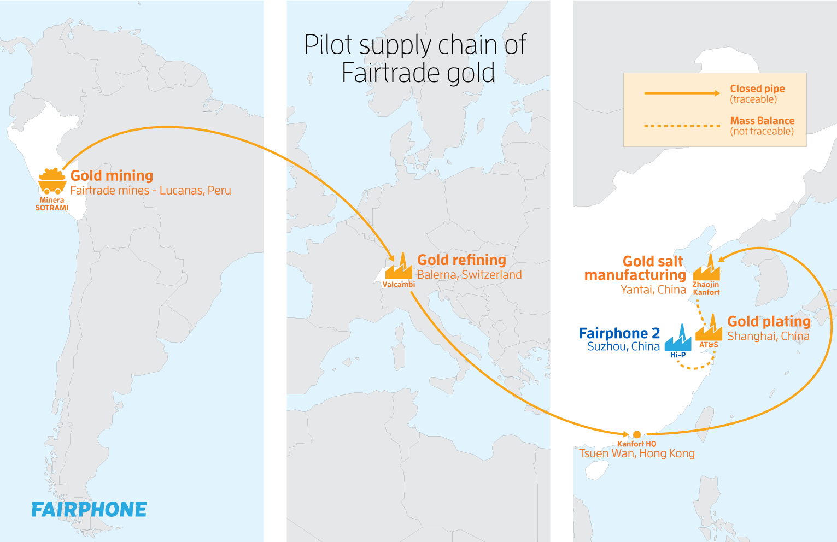
An example of one material’s supply chain
Notes:
Map: Fairphone.

Slide 6
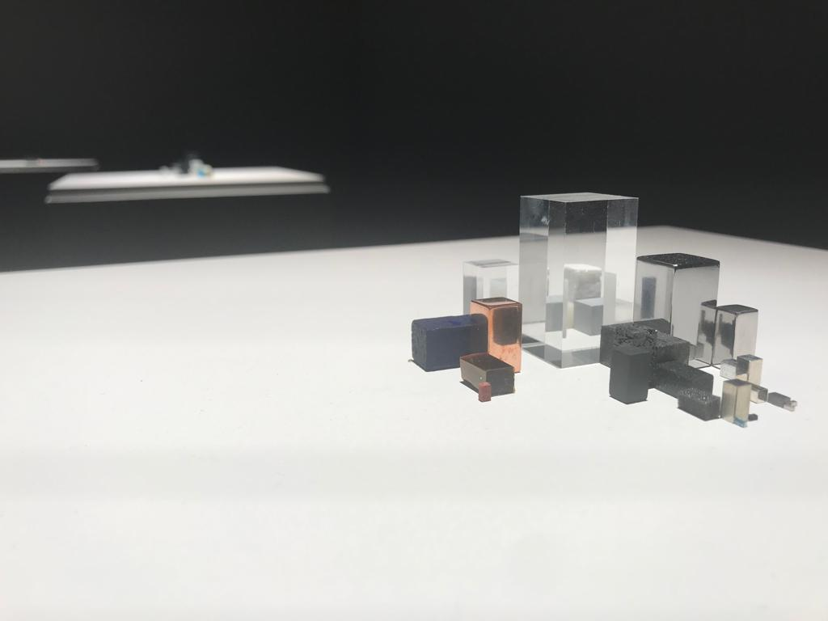
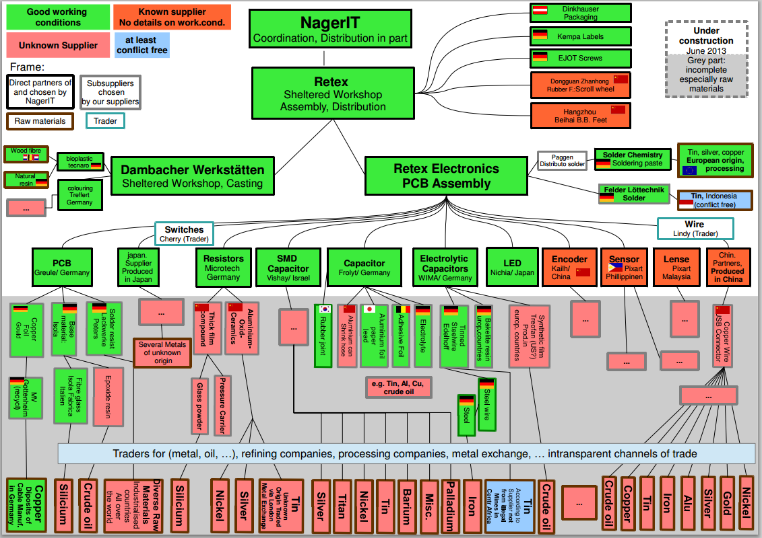
What materials and parts are there in a phone?
Studio Drift, Materialism, iPhone 4 (2018)
Fair Mouse
Notes:
Sustainable consumer can have an affect on the society in addition to voting, by acting through art and innovations. Here is one part of Studio Drift -art collective’s piece from the Materialism collection in which the artists bring out the materials of each products as well as the amounts of them in forms of cubes. These artworks were on display at Amos Rex museum in Helsinki. The other picture is of a Fair Mouse: the chart explains the materials and parts as well as the production phases of electronics.
Studio Drift, iPhone 4 (2018) - From biggest to smallest amount of raw material:
glass / stainless steel / polycarbonate / LiCo / lead / PVC / PMMA / glass fibre / copper / polyethylene / PET / aluminium / silicone / silicone rubber / PVA / kapton tape / ceramics / magnet / tin / PEN + PET / nickel / foam / silver / tantalum / phosphor / nylon / tungsten / gallium / cobalt / arsenic / cold

Slide 7
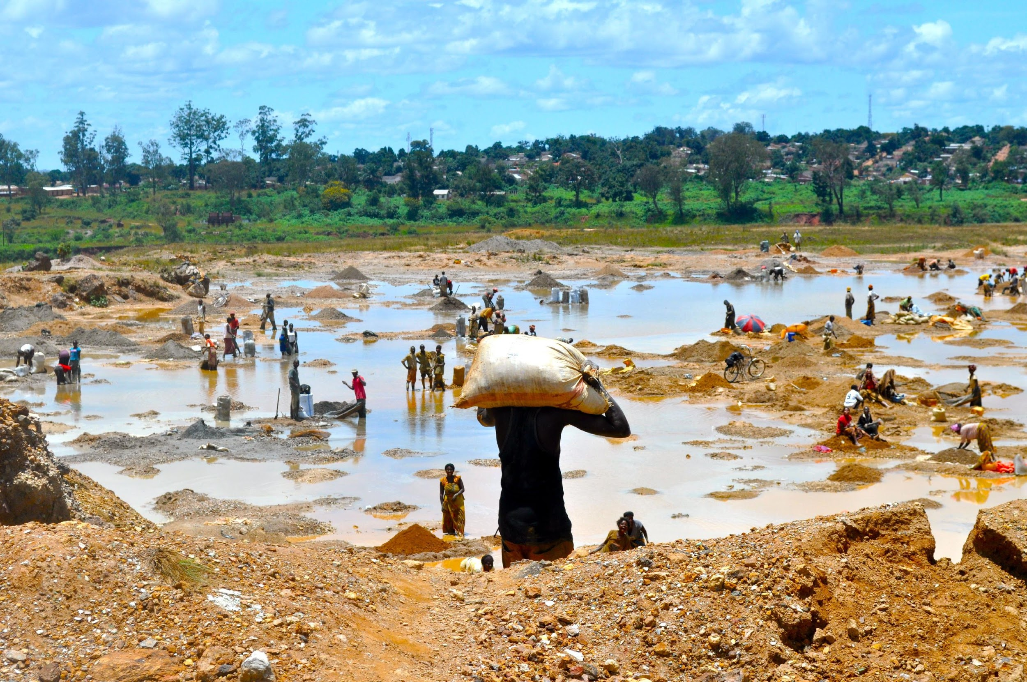
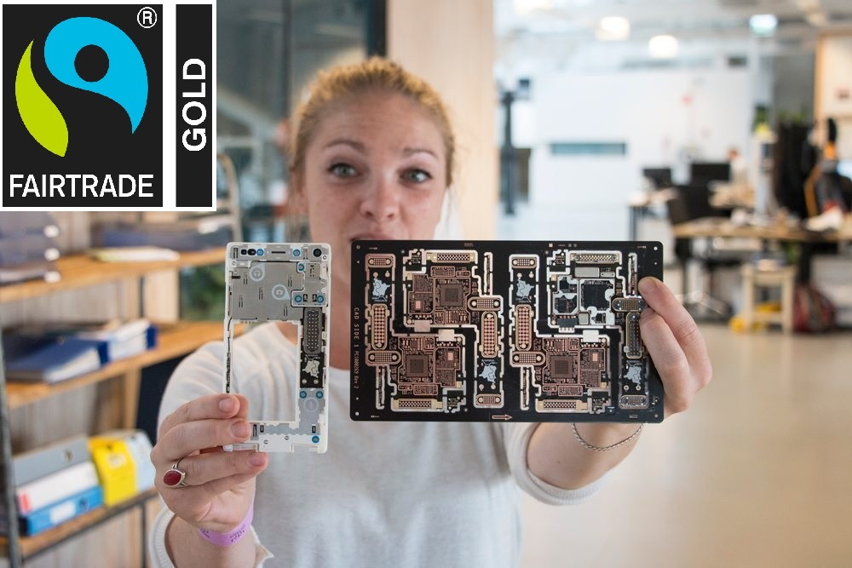
Supply chain: Global trade is a dynamic network of people, environments, animals, businesses, nations, infrastructures…
A product affects all of these before production, during use and after
→ let’s look at the life cycle of electronics
Notes:
The instructions, pictures and information about the photo exercise can be found in Eetti’s webpage: www.eetti.fi/oppimateriaalit/elektroniikka. The exercise begins with handing out photos connected to production. Then the problem photos will be distributed. There’s not one right answer to the exercise, some photos could be suited for several parts of the supply chain, and some might have several explanations. Some are harder, some easier - you might want to ask if some of the photos is particularly difficult or of which they are not sure of (what happens in that photo and where in the supply chain could be situated).

Slide 8
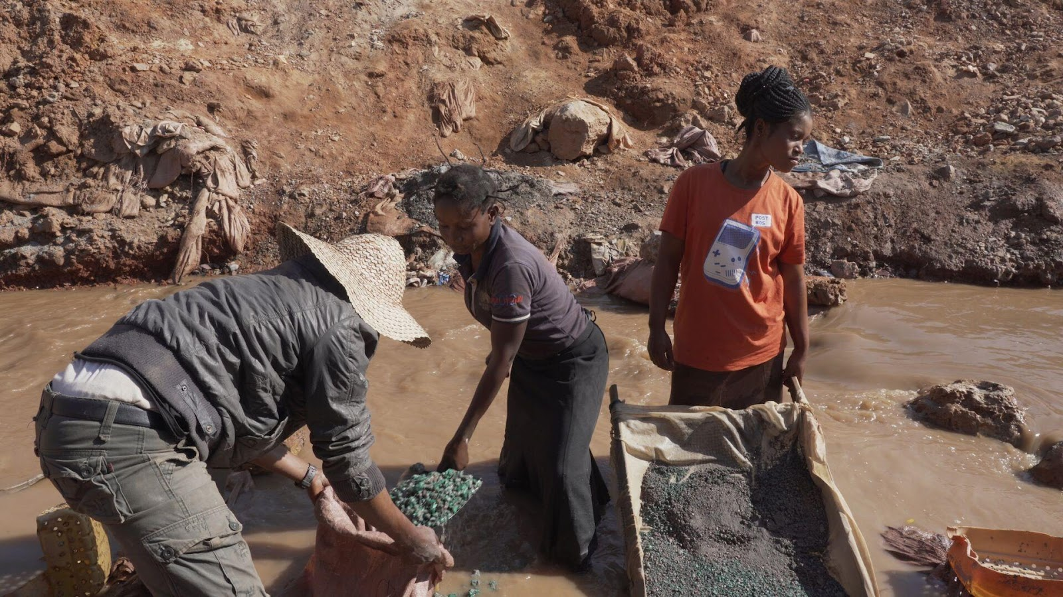
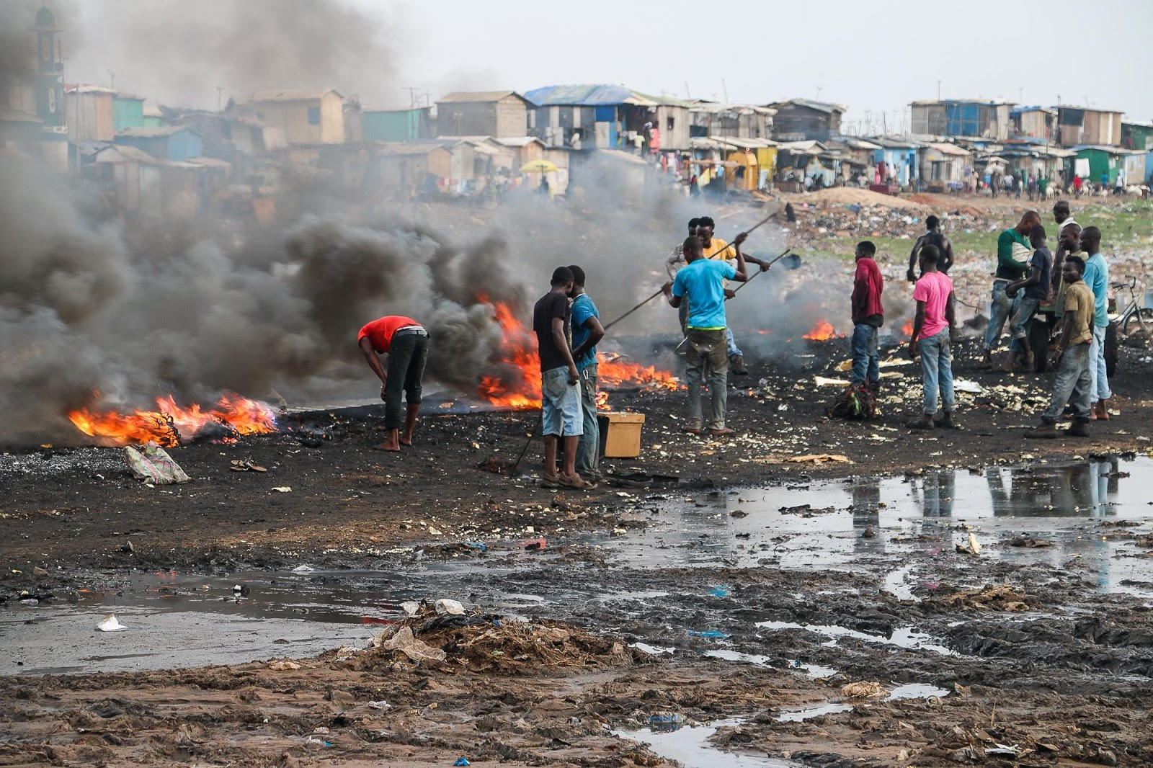
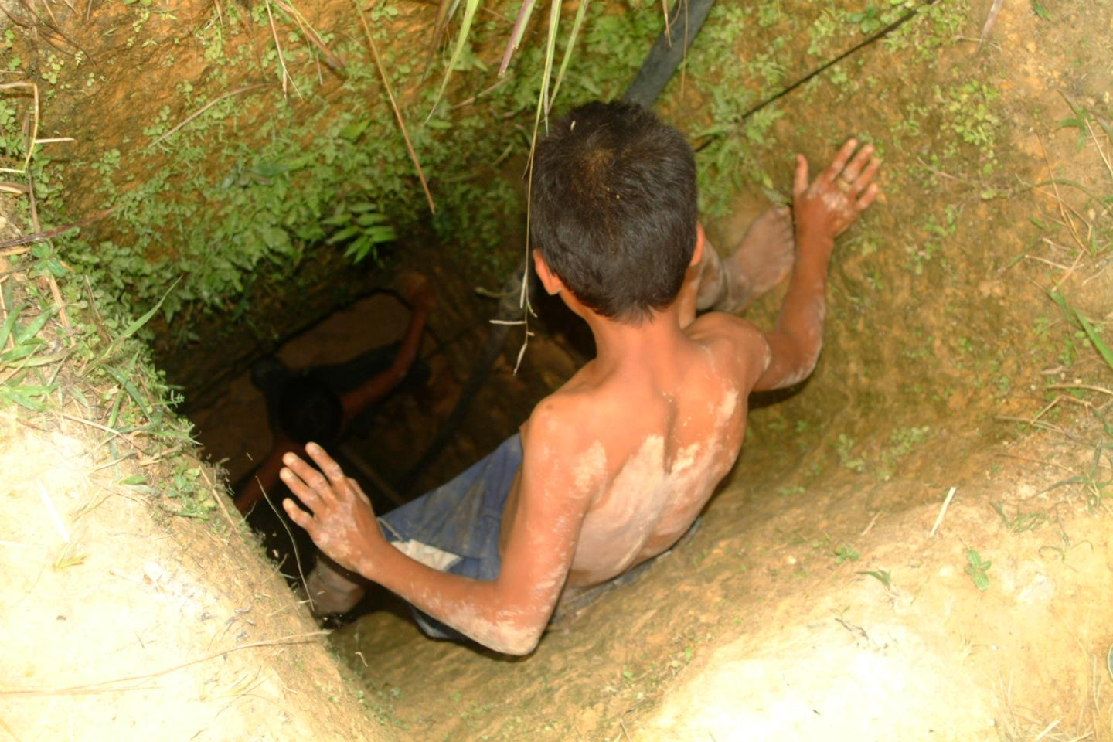
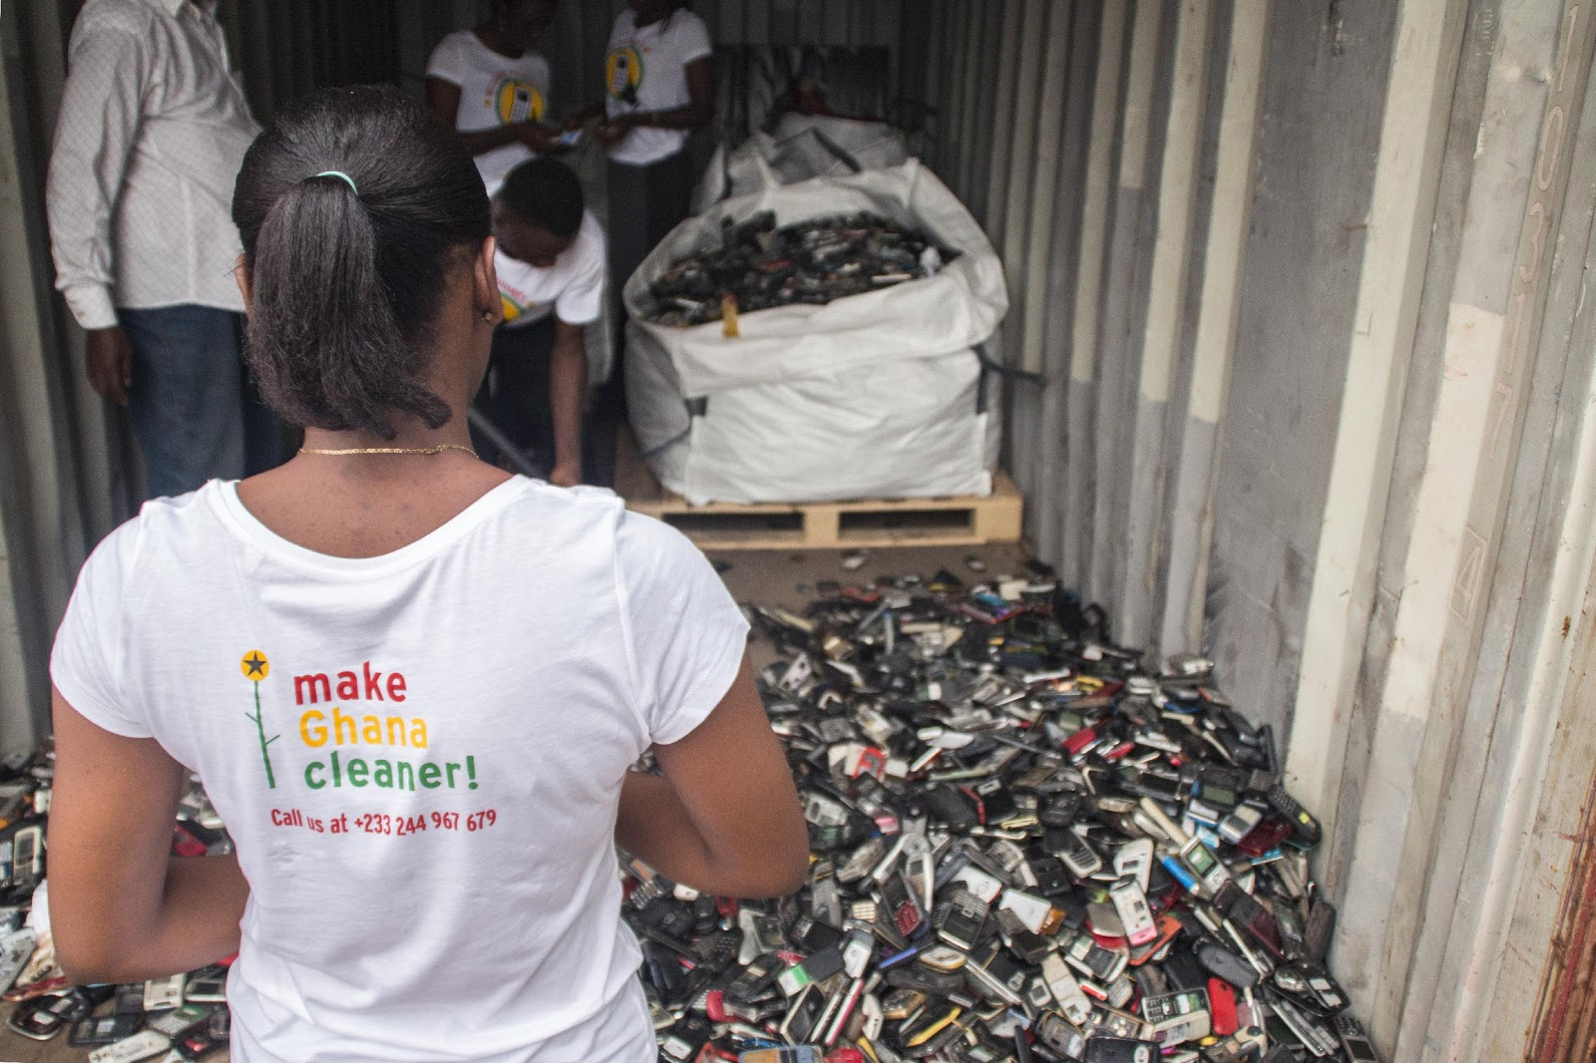

Slide 9
AAAAH, PROBLEMS EVERYWHERE!
There are environmental and human rights problems if trade is not sustainable and we overconsume.
→ The first step is to investigate supply chains and becoming conscious consumers:
What problems should we solve?
Notes:
Hand out the photos, which show the challenges of sustainable development: tillage caused my mining, forest destruction, the lack of security in the mines, child labour, contamination of local waters due to mining, emissions and smog caused by manufacturing and forest fires, problems of a factory worker, e-waste and the lack of recycling it, dumping the waste into developing countries, recycling by combusting.
Some are harder, some easier - you might want to ask if some of the photos is particularly difficult or of which they are not sure of (what happens in that photo and where in the supply chain could be situated).
These side notes “aaaah” and “yay” can be removed, but sometimes a little humour amongst the seriourness of these issues in welcome.

Slide 10
YAY, SOLUTIONS EVERYWHERE!
Let’s focus on solutions through subvertising, memes and social media.
Notes:
Problems may also enable solutions! Now let’s focus on critical consumption and the solutions of world trade.

Slide 11
Subvertising
looks at the message of the advertisement and its advertising methods
→ changing the picture, logo or text
→ presents a counter-message, comment or question
→ is funny or challenges to think about what is hidden in the advertisement
Honest, Voima
Notes:
‹#›
Here is the first subvertisement before the subvertisement gallery. Voima-magazine mad this subvertisement to bring out an anti-message amongst the advertisement of new smart phones and over consumption - this parody reminds us from the conditions of the miners. It looks just like a “real“ or original advertisement as it mocks the style of a well known brand and logo, but it is a parodic artwork which by modifying the picture and the texts, brings out the seriousness of the issue. It reminds us that there are still many challenges to be dealt with in the production of electronics in terms of development and sustainability of production.
Discussing about the photo: in subvertisements, it is usual to change the original logo (not mandatory) and bring forward with one or two sentences the issue the subvertisement is commenting on.

Slide 12
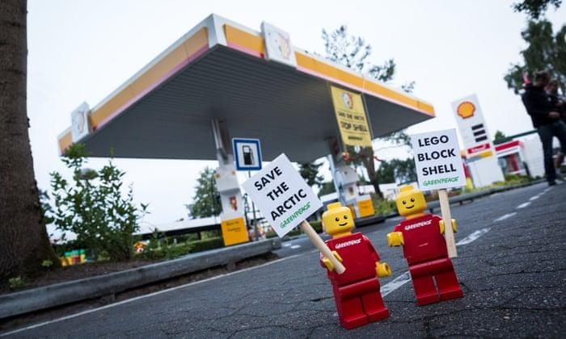
Source: Greenpeace
https://www.youtube.com/watch?v=qhbliUq0_r4
Giganttinen, Voima
Notes:
‹#›
This subertisement is a bit lighter than the previous one, because of the modification made in a well known slogan: The slogan is by Gigantti “It is just foolish to too much” has been changed and it is commenting on the wage paid for the workers making our electronics. If the price of a product is really cheap, it is quite likely that the workers have not been paid enough (living wage).

Slide 13
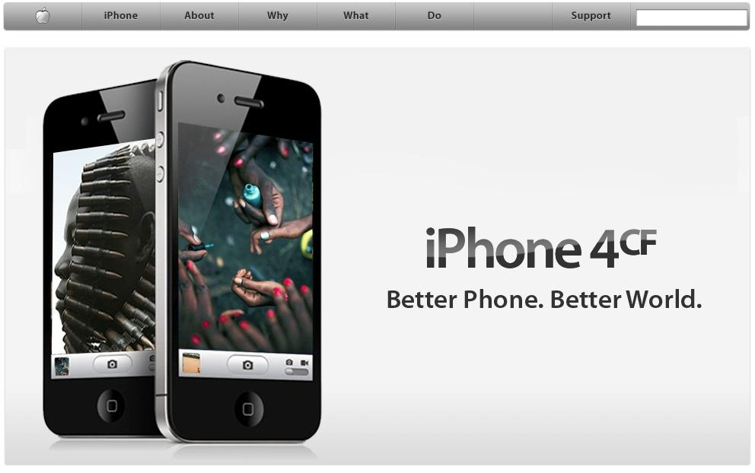
The Yes Men, iPhone 4 conflict-mineral free Parody website, humor performance
Notes:
The Yes Men. iPhone 4CF, 2010. http://apple-cf.com.yeslab.org/.
THE YES MEN -groups’ page on subvertisements mocks the smartphone industry, especially Apple and its design and advertising. On their page, Apple launches “the first ecologically and socially sustainable phone”, iPhone 4CF (conflict-mineral free iPhone), which supply chain is being supervised: the parts of the phone don’t include any conflict minerals, and the conditions in the assembly line (manufacturing) as well as fair wage have been considered. The page has now been shut down, but it got the consumers, producers and dealers to talk about ethical electronics and corporate responsibility.
More subertisements at: https://www.instagram.com/p/Botj4_lHaVz/

Slide 14
Memes make use of familiar pictures and dark humor
Notes:
Memes on sustainability of production and products.

Slide 15
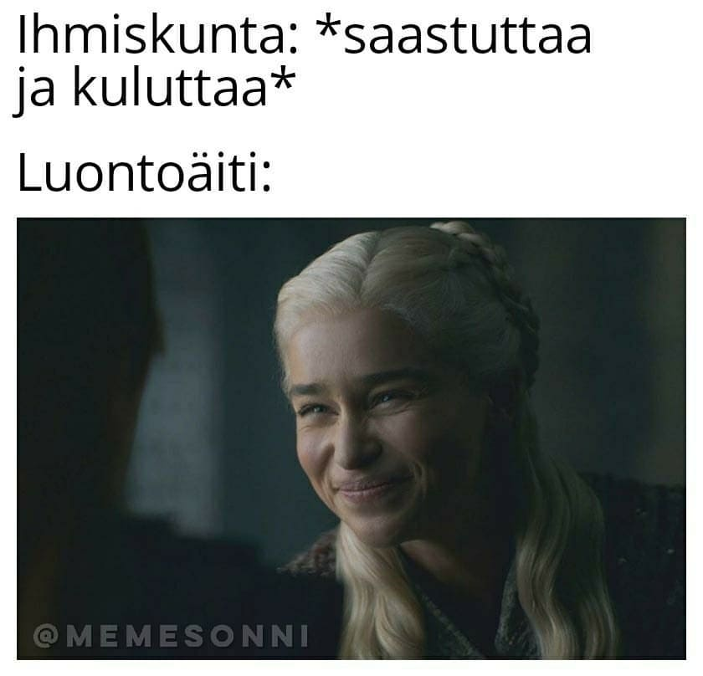
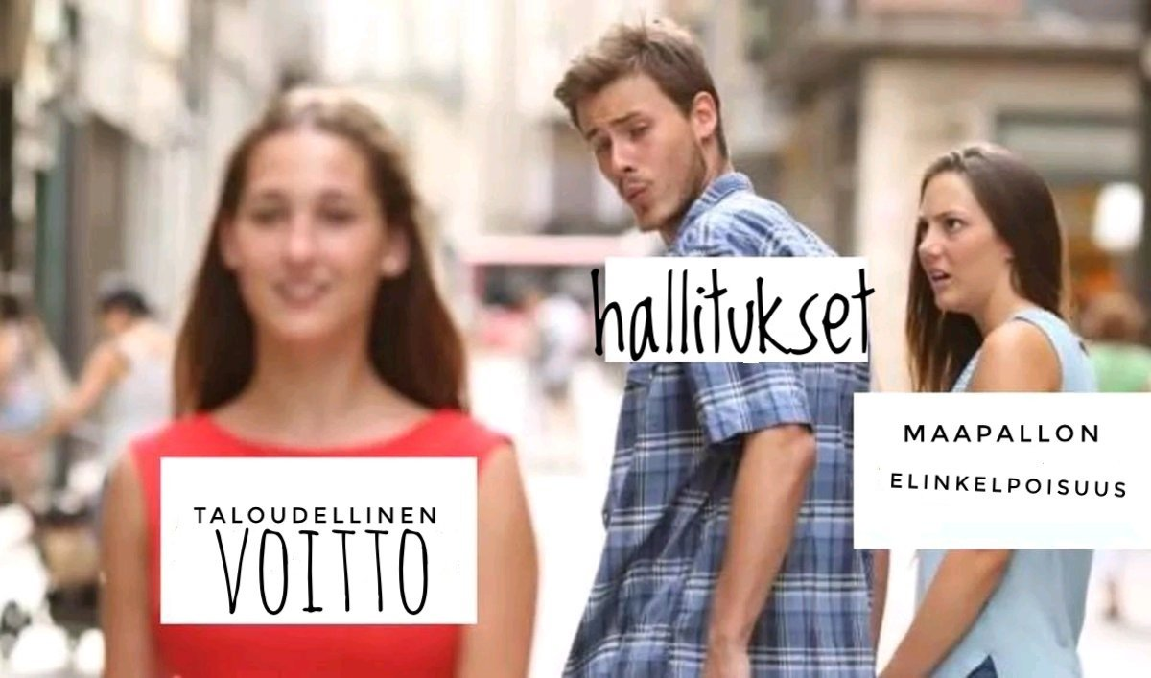
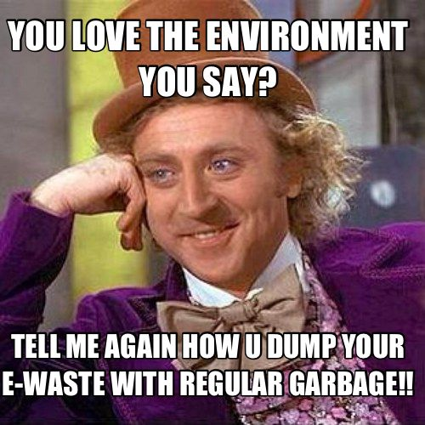
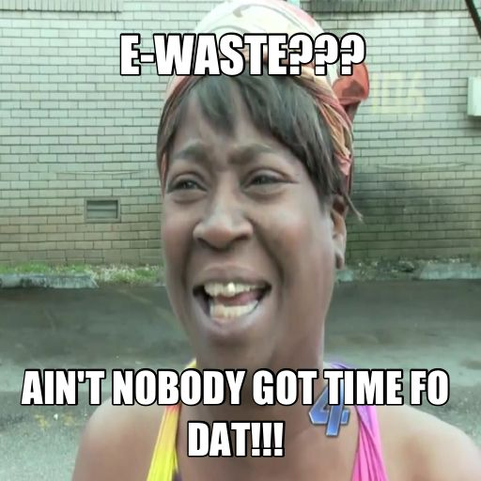

Slide 16
WE NEED SOLUTIONS AND COMMUNICATION!
Create your own meme or short social media post on your phone. The theme is electronics production and conscious consumerism.

Slide 17
ACTIVISM: YOUR OWN MEME OR SOCIAL MEDIA POST
1. Meme: Find a meme generator, for example Imgflip. Choose a picture and write a text about electronics or consumerism. Save the picture or take a screenshot.
Social media post: Choose a picture or subvertisement you would like to share. Write a short message about electronics or consuming on the picture or as a caption. Save the picture or take a screenshot.
2. Send the picture to Helena: lehtihelena@gmail.com
If you want, you can post the picture on Instagram and tag Eetti_ry.
* Eetti might share your picture, so if you want, write your names in the message.
Notes:
Add here your own e-mail or some other destination, where the memes and social media posts can be send to. You can set out an exhibition or a gallery of the productions at the end of the workshop.
It might be helpful to go through the tips for making a difference (slides 28-31) with those students planning to make a social media post.

Slide 18
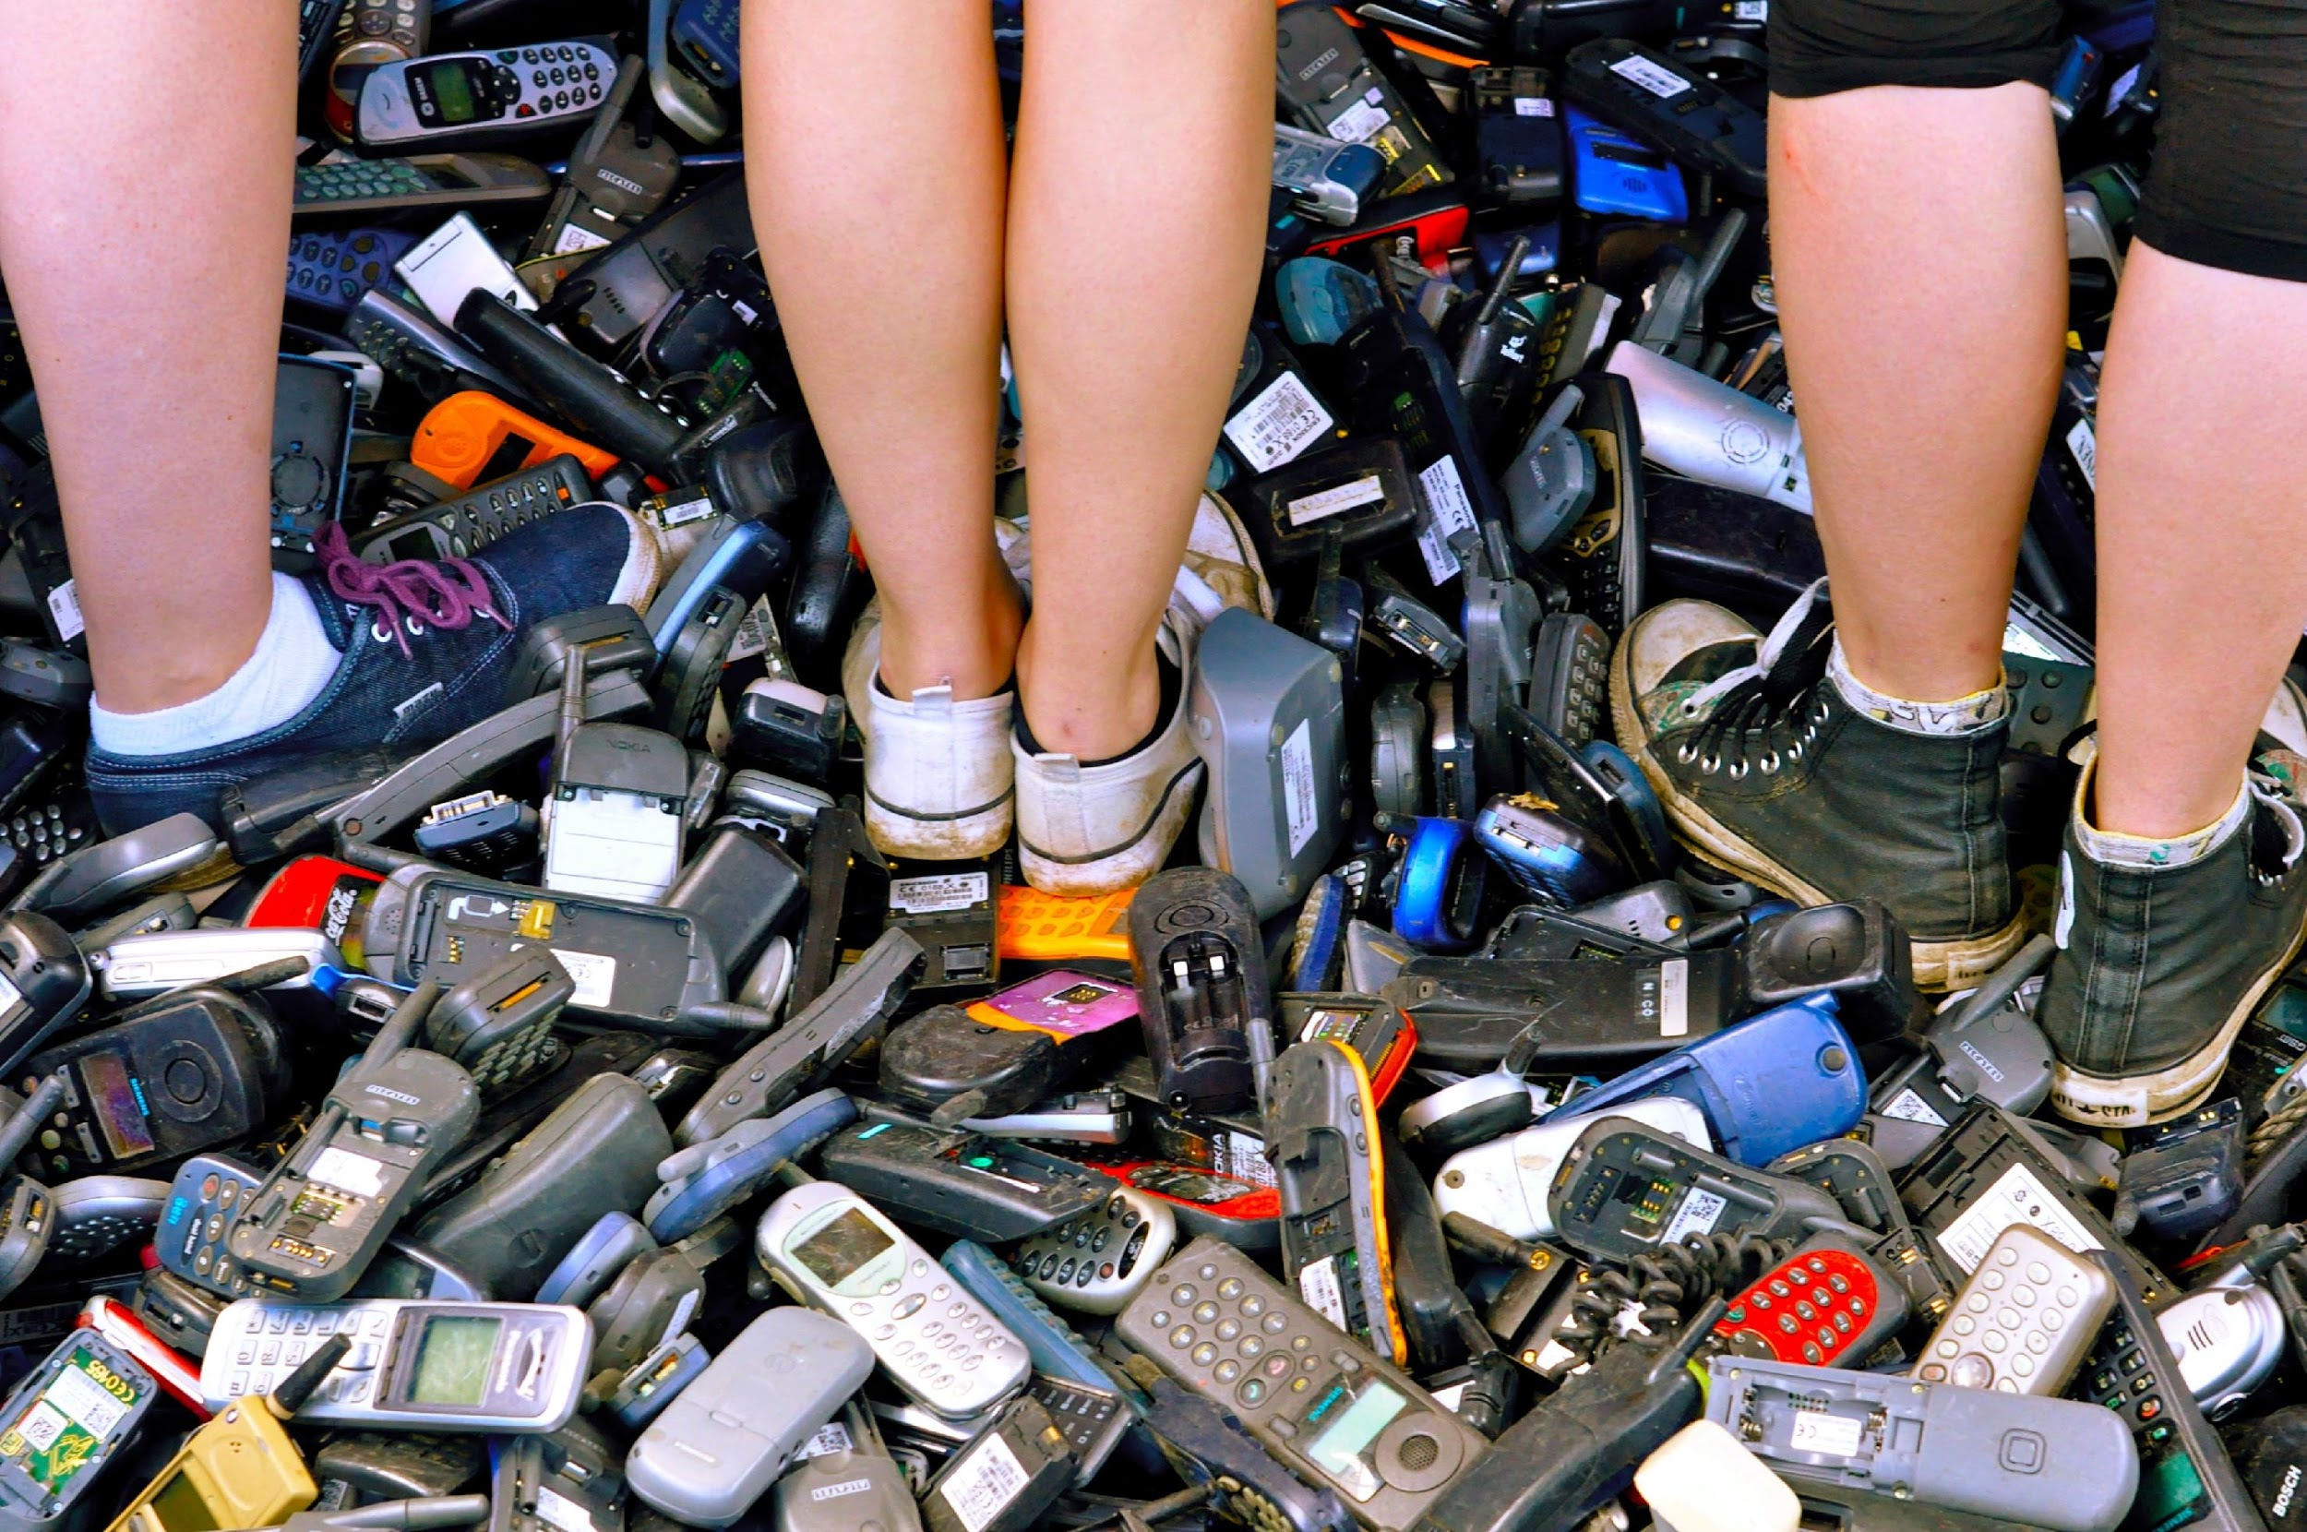
Tips for making a difference: Less consumption, emissions and waste
The biggest thing you can do is to not buy and to use products longer. When consumption and emmisions go down, the world and we will do better.
Value and maintain
Fix broken items
Recycle right.
Compare: choose quality, what you need, maybe choose used or ethical.
Study, volunteer or work with sustainable development.
Give feedback to brands.
Talk.
Vote.
Notes:
It might be useful to consider the whole lifecycle of a phone (and other products): What do I already have? What do I do, when it breaks? Do I really need more or do I just want/wish for something new? Does buying make me happy - why, why not? What should be the priority (certificates, quality, endurance)?
Additional information about sustainable consumption and corporate responsibility of human rights:
https://eetti.fi/toiminta/teemat/vastuullinen-kuluttaminen/
https://eetti.fi/toiminta/teemat/yritysten-ihmisoikeusvastuu/

Slide 19
What thoughts do you have about the workshop? THANK YOU!
www.eetti.fi www.kuilutumpeen.fi
www.hairikot.voima.fi
Notes:
Additional information, thanks, feedback.

Slide 20
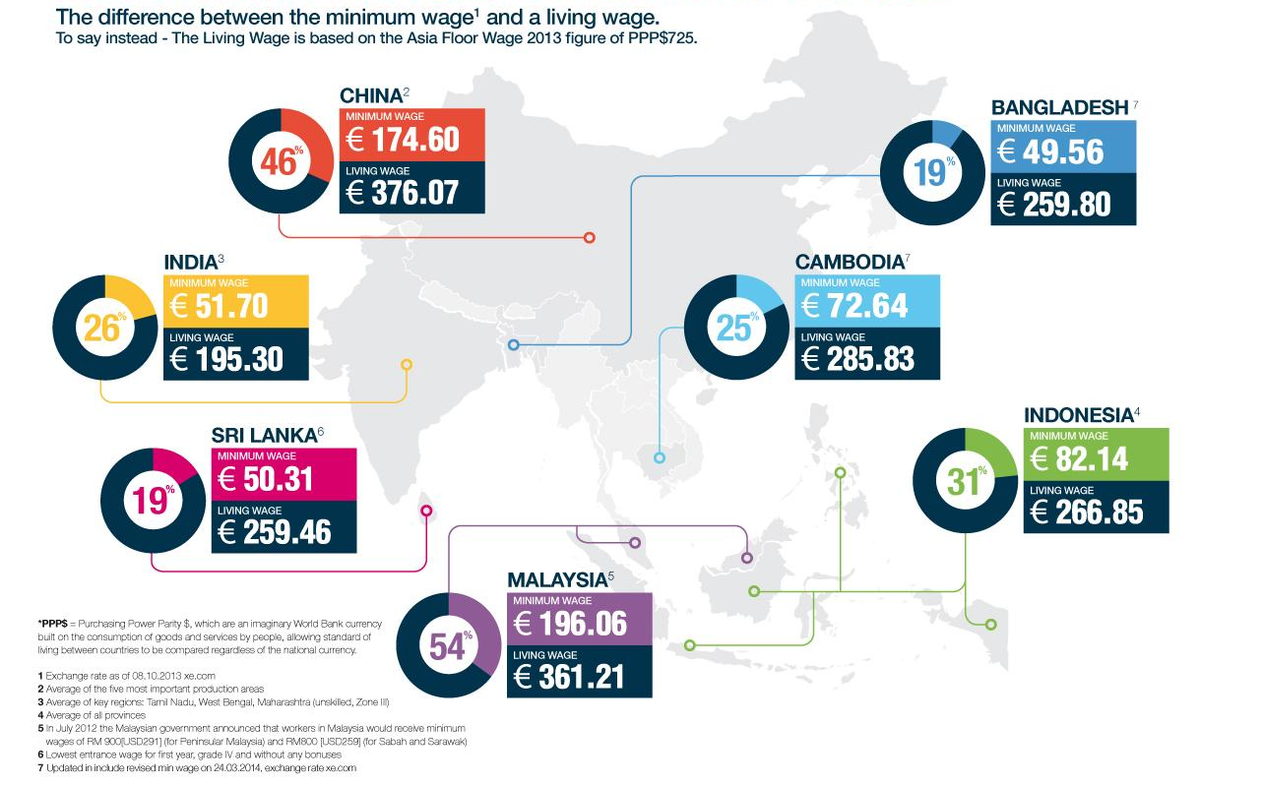
Minimi vai elämiseen riittävä palkka?
Lähde:
Notes:
Kenkä- ja vaatetuotantoon kehitysmaissa liittyy useita ihmisoikeusriskejä. Yksi suurimmista ongelmista on, että monissa tuotantomaissa työntekijöiden palkat eivät riitä elämiseen, vaikka he saisivatkin laissa määritellyn minimipalkan.
Elämiseen riittävällä palkalla tarkoitetaan palkkaa, jolla työntekijä pystyy hankkimaan itselleen ja perheelleen ihmisarvoisen elintason. Tällainen palkka riittää tyydyttämään perheen perustarpeet, kuten riittävän ravinnon, asumisen, terveydenhuollon, vaatetuksen, liikkumisen ja lasten koulutuksen. Lisäksi se mahdollistaa pienimuotoisen säästämisen.
Esimerkiksi Kiinassa minimipalkka on keskimääräisesti noin puolet elämiseen riittävästä palkasta ja Bangladeshissa vain viidennes. Monissa Itä-Euroopan maissakaan palkat eivät riitä elämiseen.
Lisätietoa ja lukuja:
https://eetti.fi/toiminta/teemat/vaatteet-ja-kengat/
https://www.finnwatch.org/images/pdf/RaporttiERP.pdf

Slide 21
Notes:
Lenkkitossun hinta -pelin voi ladata Eetin kotisivuilta ja laminoituna niitä voi lainata toimistolta: www.eetti.fi/oppimateriaalit/vaatteet
Suomalaiset ostivat vuonna 2016 noin 17 miljoonaa paria kenkiä. Suurin osa näistä kenkäpareista on valmistettu jossain muualla kuin Suomessa, pääosin Aasiassa. Vaatteita tuotiin Suomeen eniten Kiinasta ja toiseksi eniten Bangladeshista.
Lähes 90 prosenttia kaikista maailman kengistä tehdään Aasiassa, jossa suurin tuottajamaa on Kiina; se tuottaa lähes kaksi kolmasosaa kaikista maailmassa myydyistä kengistä. Seuraavaksi eniten kenkiä tuotetaan Intiassa, Vietnamissa ja Indonesiassa.
Laskelmien mukaan työntekijät saavat Indonesiassa tuotetusta 120 euron hintaisesta kengästä noin 2,5 euroa eli vähän yli 2 prosenttia kokonaishinnasta. Suurin osa kengän tuotosta menee brändiyritykselle ja jälleenmyyjälle.
Lisätietoa ja lukuja: https://eetti.fi/toiminta/teemat/vaatteet-ja-kengat/

